Slide 1

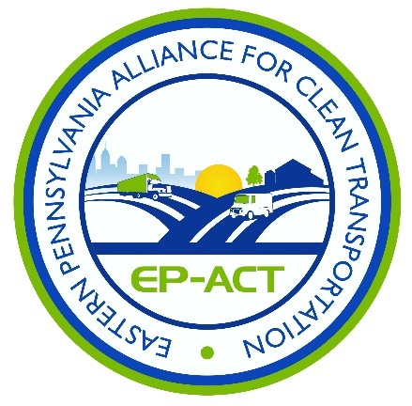
The Future of Busing: Propane, Electric and Other Alternative Fuels
June 17, 2021

Slide 2


Anti-Trust Statement
PSBA activities and discussions shall be avoided which might be construed to:
  raise, lower, stabilize or otherwise be determinative of prices;
  regulate production or output;
  allocate customers or markets;
  encourage boycotts or refusals to deal;
  foster unfair trade practices;
  assist in monopolization; or
  in any way violate federal or state antitrust law.
Even informal settings at PSBA -sponsored events, members should not discuss any matters that might be construed as touching upon any of these issues.

Slide 3
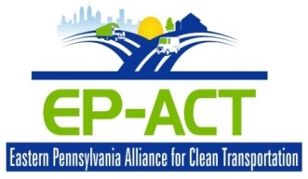
What is Clean Cities?
Sponsored by the DOE’s Office of Energy Efficiency and Renewable Energy's Vehicle Technologies Program (EERE)
A Public/Private Partnership for Clean Fuel Vehicles and Fuel Efficient Technologies
Provides a framework for businesses and governments to work together as a coalition to enhance markets
Coordinate activities, identify mutual interests, develop regional economic opportunities, and improve air quality

Slide 4
Why Clean Cities?
Reduced petroleum consumption
Clean Cities advances the energy, economic, and environmental security of the United States by supporting local actions to cut petroleum use in transportation.
Reduced greenhouse gas (GHG) emissions
Reduced dependence on imported petroleum
Notes:
Clean Cities is a program within the U.S. Department of Energy’s (or DOE) Vehicle Technologies Office.
DOE’s mission is to ensure the United States’ security and prosperity by addressing energy, environmental, and nuclear challenges through transformative science and technology solutions.
Clean Cities was established in response to the Energy Policy Act of 1992, and is a community-based program that creates partnerships in the public and private sectors. Its mission is to advance the energy, economic, and environmental security of the United States by supporting local actions to cut petroleum use in transportation.
The benefits of the Clean Cities program include:
Reduced petroleum consumption. Currently, our transportation system and much of our economy runs on petroleum. In fact, transportation accounts for more than 70% of our nation’s petroleum use, with the large majority of it being used for on-road vehicles. Through Clean Cities’ portfolio of alternative fuels and advanced vehicle technologies, the program has saved more than 9.5 billion gallons of petroleum since the program’s beginning in 1993.
Reduced greenhouse gas, or GHG, emissions. Transportation is also a major cause of climate change and contributes to more than one quarter of the United States’ GHG emissions. Many of the solutions in the Clean Cities portfolio substantially reduce GHG emissions from vehicles, including biofuels, plug-in electric vehicles (also known as PEVs), idle reduction, and fuel efficiency. Clean Cities prevented more than 5.6 million tons of GHG emissions in 2015 alone. That’s equivalent to removing nearly 1.3 million passenger cars off the road for the year.
Reduced dependence on imported petroleum. Almost 25% of the petroleum used in the United States is imported. Increasing our use of alternative fuels increases the diversity of our fuel sources, so that we don’t need to rely on petroleum alone. In addition, most alternative fuels are domestically produced, so they support our local and national economy.

Slide 5




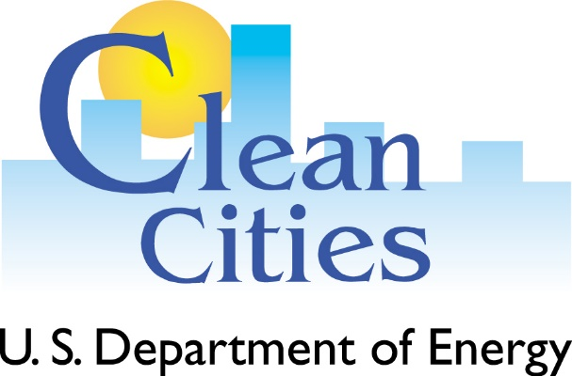




Portfolio
Reduce
Replace
Eliminate
Notes:
Over the years, Clean Cities has kept up with a rapidly changing industry on its mission to cut petroleum use. The program’s activities fall under a trifecta of strategies:
Replace petroleum with alternative and renewable fuels, including biodiesel, electricity, ethanol, hydrogen, natural gas, propane, and other fuels;
Reduce petroleum consumption through smarter driving practices and fuel economy improvements; and
Eliminate petroleum use through idle reduction and other fuel-saving technologies and practices.

Slide 6
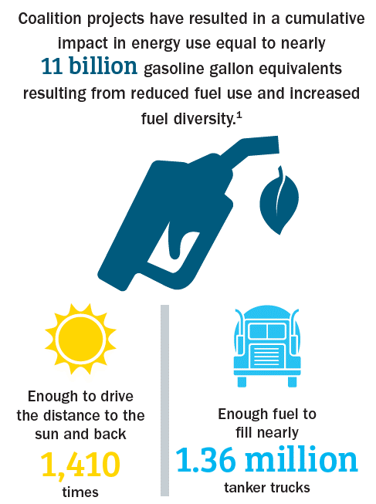
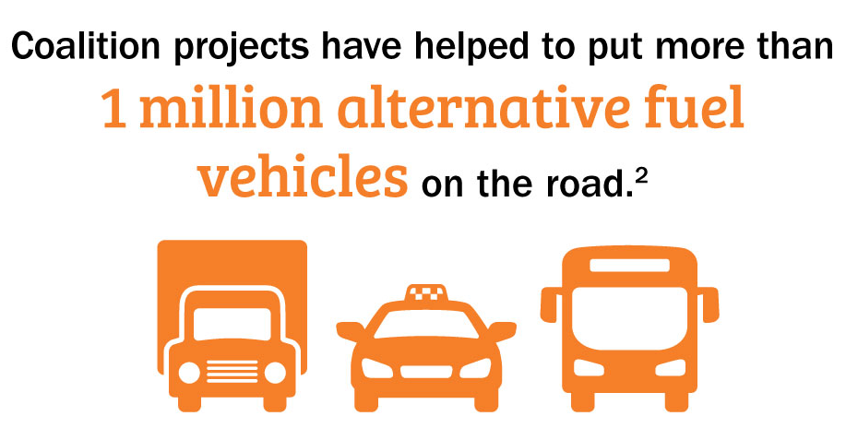
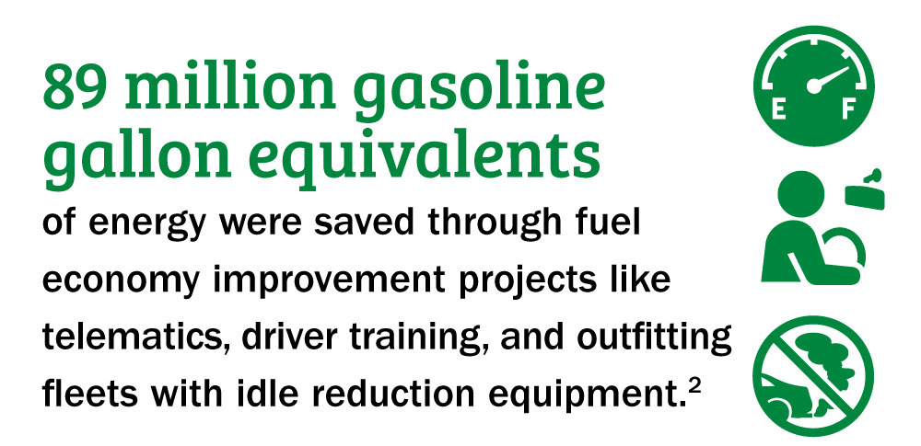
Measuring Clean Cities Coalition Impact
cleancities.energy.gov/coalitions
Notes:
Strong partnerships with public and private transportation stakeholders has enabled the Clean Cities Coalition Network to achieve remarkable results over the years. Clean Cities coalitions provide data that are combined and measured as energy use impact (EUI) in gasoline gallon equivalents (GGE). EUI is a metric that measures progress in both energy savings from efficiency projects and increased fuel diversity through the use of domestic alternative fuels. Both components provide consumers and businesses with more energy choices and support DOE’s mission to pursue more secure, reliable, and affordable energy choices.
In 2019, Clean Cities coalition activities resulted in an EUI of over 1 billion GGE, comprised of net alternative fuels used and energy savings from efficiency projects. This makes for a cumulative impact in energy use equal to nearly 11 billion gasoline gallon equivalents.
Additionally, Clean Cities is responsible for helping to place more than a million alternative fuel vehicles (also known as AFVs) on the road in 2019.
Fuel economy improvement projects like telematics, driver training, and outfitting fleets with idle reduction equipment have saved 89 million GGEs of energy in 2019 alone.
The Vehicle Technologies Office regularly encourages applicants to partner with Clean Cities on proposals that deepen the impact of Clean Cities, which presents a great opportunity for stakeholders to contribute to innovative projects. VTO typically releases funding opportunities at least once a year, including funding for a variety of Technology Integration projects.

Slide 7
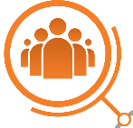
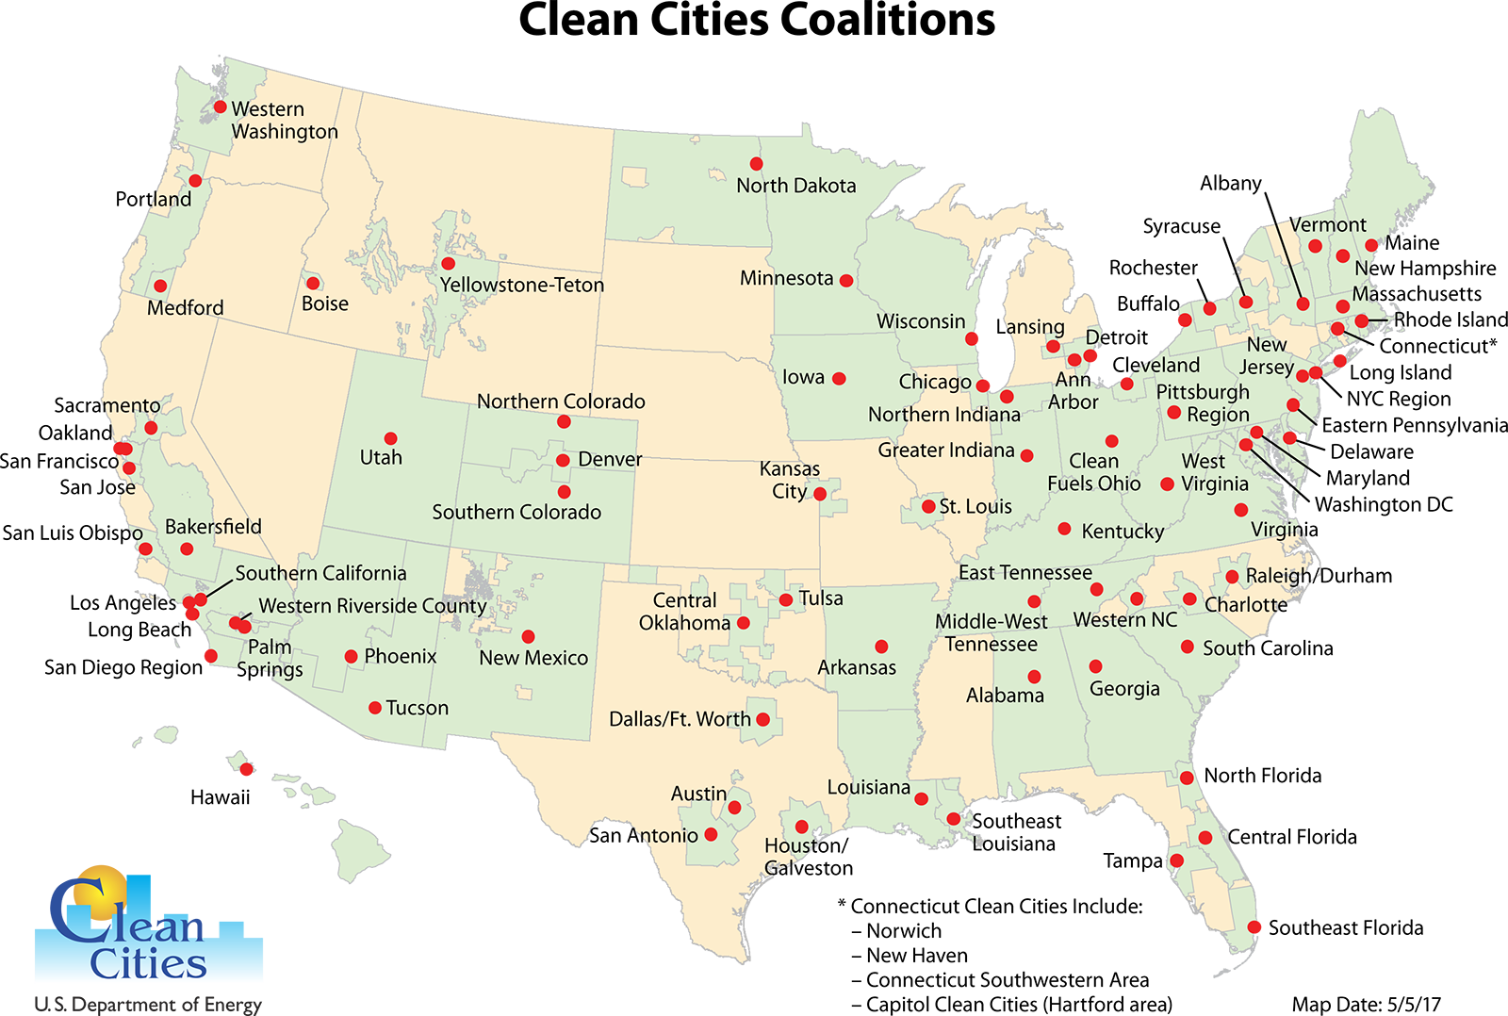
Local Partnerships: Clean Cities Coalitions
National network of nearly 100 local coalitions
82% of the total U.S. population lives inside coalition boundaries
Nearly 900,000 alternative fuel vehicles (AFVs)
Notes:
So, let’s talk more about the first node in the web that I showed you earlier in the presentation—about partnerships—specifically, local partnerships. Nearly 100 local coalitions serve as the foundation of the Clean Cities program by working to cut petroleum use in communities across the country. About 82% of the total U.S. population lives inside Clean Cities coalition boundaries. Additionally, Clean Cities is responsible for helping to place more than 900,000 alternative fuel vehicles (also known as AFVs) on the road as of 2018.
Each coalition is led by an on-the-ground Clean Cities coordinator [like me] who tailors projects and activities to capitalize on the unique opportunities in their region.
Coordinators serve as both educators and problem solvers for their stakeholders.

Slide 8
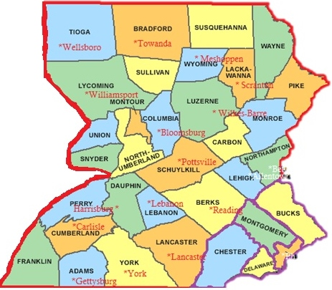
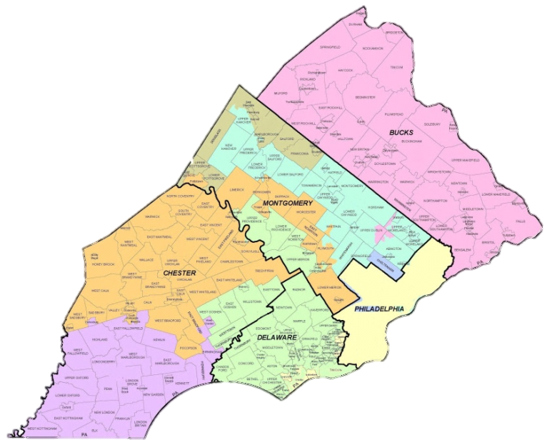
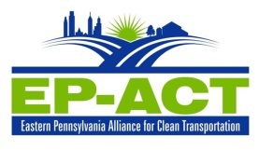
The where of EP-ACT
EP-ACT

Slide 9
Who is EP-ACT?
Non-profit 501 (c) 3 organization
Comprised of Public and Private companies
Municipalities and Utilities
Assist with Grants/writing
Project Management
Education and Outreach
Tiered Levels of Stakeholder Membership
Notes:
Public. Private; utilities; universities, School Districts, industries;

Slide 10
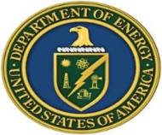
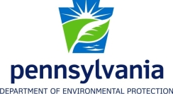






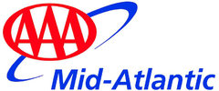
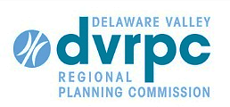
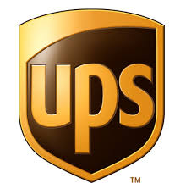

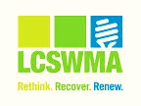
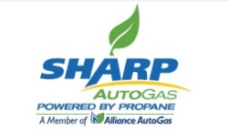
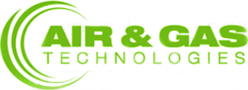

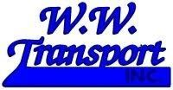
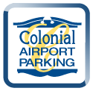
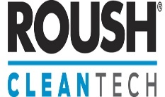





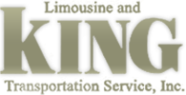





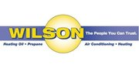








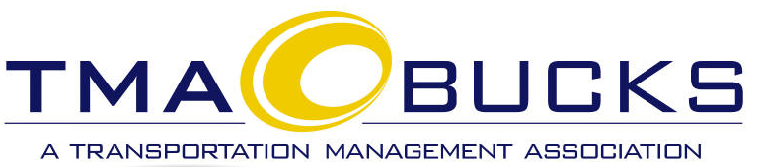
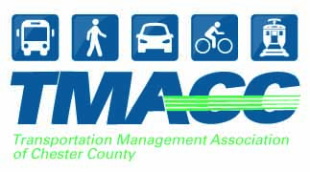
Who is EP-ACT?
Notes:
Public. Private; utilities; universities, School Districts industries;

Slide 11

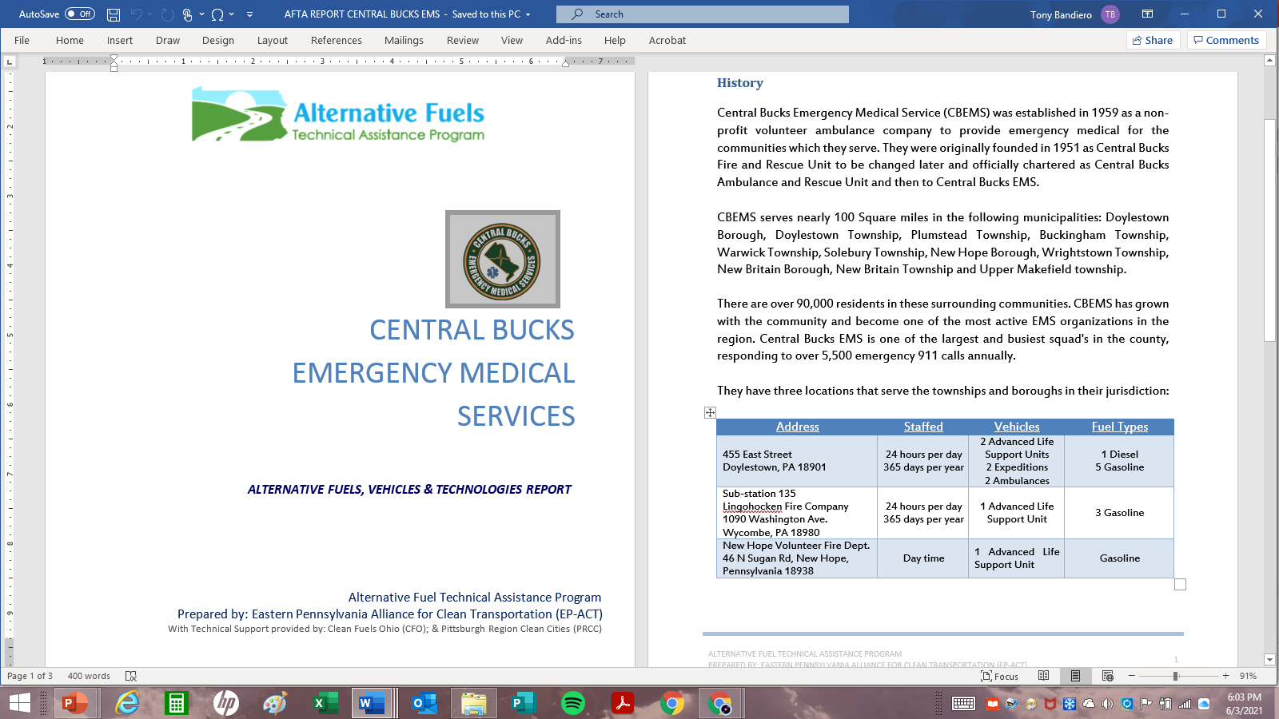
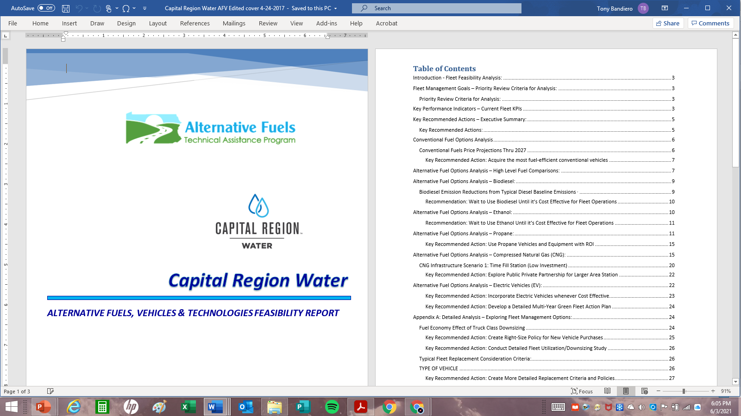

Past Projects

Slide 12
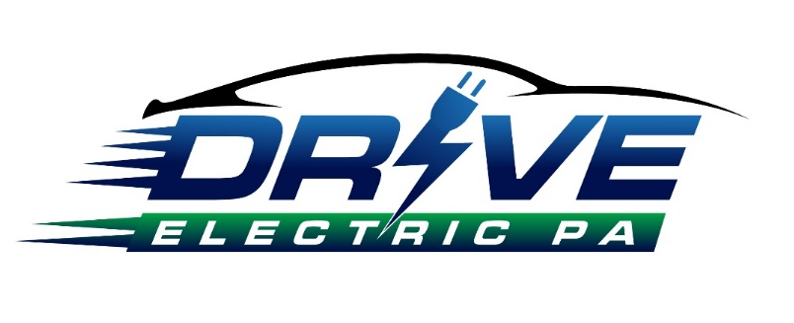
Current: Activities/Initiatives/Projects
3 Committees
Education & Outreach
Infrastructure
Procurement
The Drive Electric Pennsylvania Coalition was formed to help plan and implement strategies for the adoption of electric vehicles throughout Pennsylvania. The coalition consists of government, industry, utility, universities, public and private companies who wish to help spur the adoption of Electric Vehicles (EV's) in The Commonwealth of Pennsylvania.

Slide 13
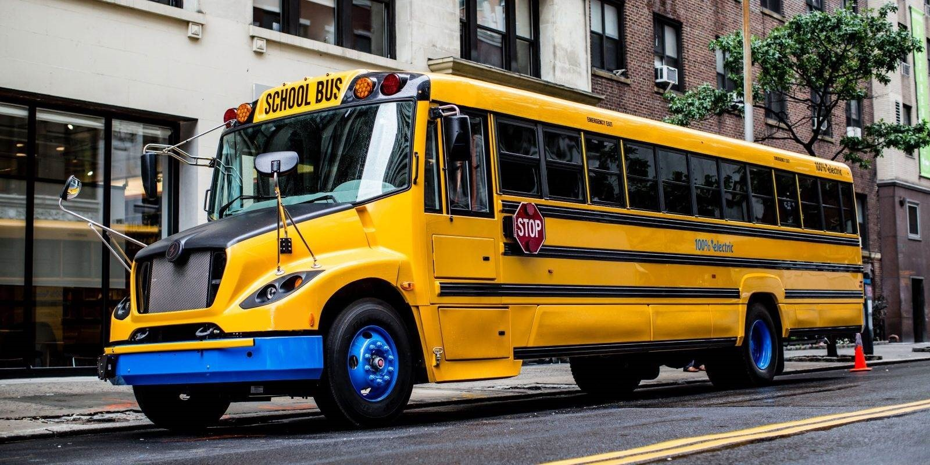
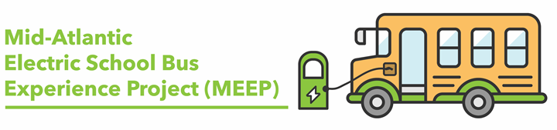
Current Projects:
Tony Bandiero
215-990-8200
tfbandiero@ep-act.org

Slide 14
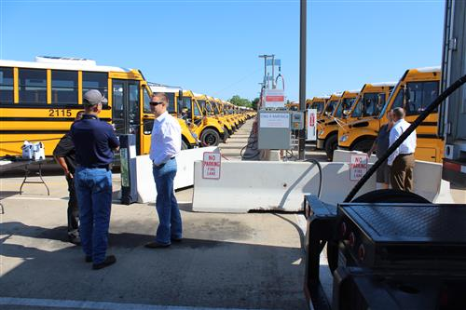
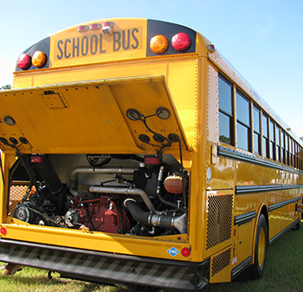
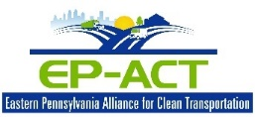
Compressed Natural Gas Deployed School Buses
Rose Tree/Media SD CNG Conversion Initiative
14 dedicated CNG
9 converted
1 CNG station built
Completed
Lower Merion SD CNG Conversion I
Started in 1995
Currently have 63 CNG School Buses
Have a large fueling station
Completed
80 CNG School Buses on the road in EP-ACT Territory

Slide 15
Project Overview
The Mid-Atlantic Electric School Bus Experience Project (MEEP) awarded by the U.S. Department of Energy is working with school bus manufacturers, Clean Cities coalitions and other partners to provide free electric school buses for 6-8 week demos in selected school fleets in Virginia, Maryland, Washington DC, Pennsylvania, and New Jersey over the next three years.
These short-term demonstrations are a fantastic opportunity for school administrators, mechanics, drivers, faculty, students and community members to experience electric school buses firsthand on their existing routes, without any cost or long-term commitment.
Project Goals:
Increase awareness and adoption of electric school buses in the project region
Build local support for electric school buses through direct experience
Gather operational data to support future decision-making and fleet funding applications

Slide 16
Project Overview
Details
Demonstrations implemented in at least one school fleet per state.
Additional demos can be supported as logistics and budget allow
Level 2 charger provided to each demo fleet with technical assistance for installation
Project design, management, coordination, technical assistance, outreach/promotion and Level 2 chargers are covered by DOE grant
Cost share is provided primarily by OEMs by tracking duration of bus demonstrations
Term: January 2021 through December 2023.

Slide 17
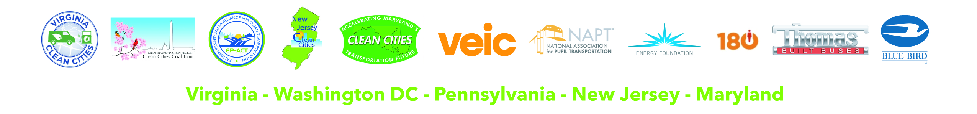
Project Partners
Partners include: Clean Cities Coalitions for VA, DC, NJ, PA and MD, National Association for Pupil Transportation, VEIC, Al Pollard of the Energy Foundation, Generation 180, State Air Quality Agencies (VA DEQ / MDE / NJ DEP) and Regional Electric Utilities (Dominion Energy / BGE / PEPCO / PECO).

Slide 18
Project Partners
What we need from you to participate:
Work with us to assure a state-compliant bus for one or more periods between now and December 2023
Coordinate with us on placement schedule and logistics
Participate in local events during the deployment(s)
Enable us to collect/share basic operational data from deployments
Work with us to document cost-share

Slide 19
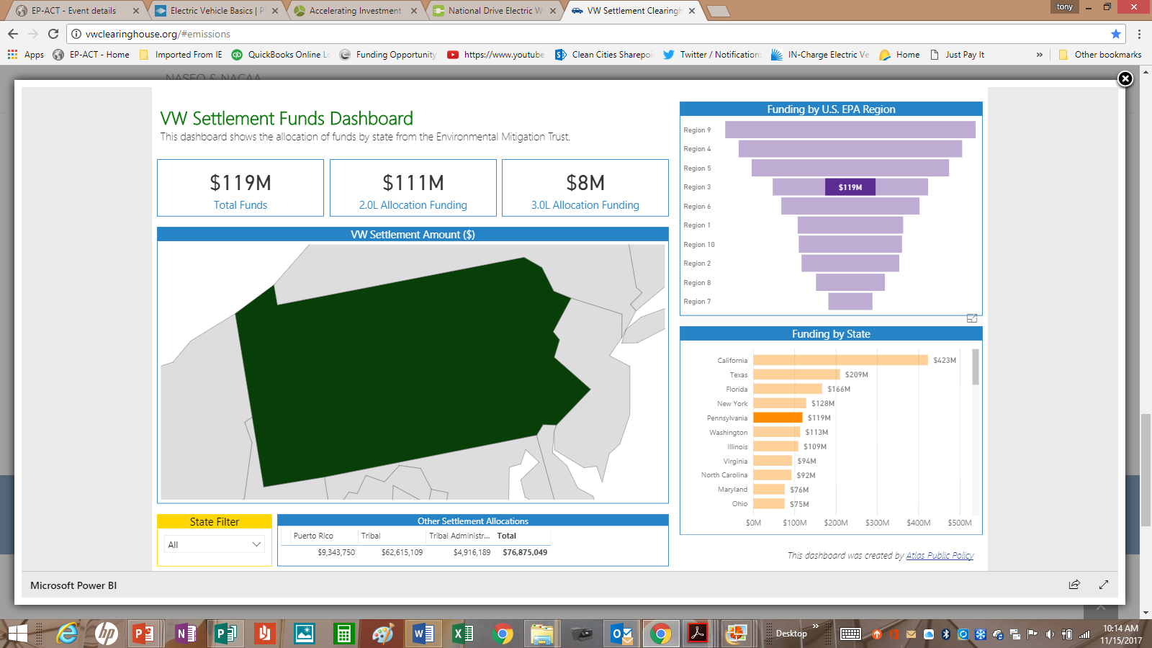
Current Initiatives
Driving PA Forward

Slide 20
Driving PA Forward

Slide 21
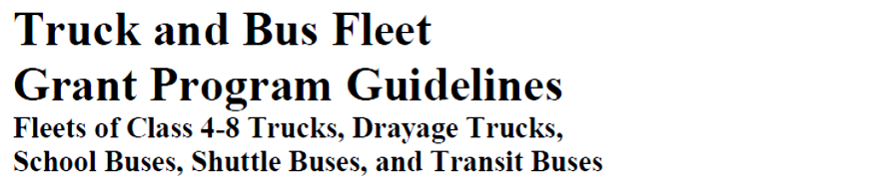
Driving PA Forward
2020 $3mm available

Slide 22
Driving PA Forward

Slide 23
Driving PA Forward

Slide 24
Driving PA Forward
2020 $6.4mm available
$500,000 Max per entity
5 bus replacement max
Scrappage required

Slide 25
Driving PA Forward

Slide 26
Alternative Fuel Incentive Grant

Slide 27
Alternative Fuel Incentive Grant
Usually 3 categories for grant application:
Vehicle Retrofit or Purchase Projects
Alternative Fuel Refueling Infrastructure Projects
Innovative Technology Projects
~ $5mm per year – funded through utility tax

Slide 28
Alternative Fuel Incentive Grant
  Vehicle Retrofit or Purchase Projects
  Pays for the incremental cost of the new bus
  LNG, CNG, LPG, Hydrogen, biodiesel blends > 20% and electric- OK
  Registered in PA (2 year min)
  Lessee ok but need additional paperwork to be submitted
  Maxed out at $300k per application

Slide 29
Alternative Fuel Incentive Grant

Slide 30
Alternative Fuel Incentive Grant
Alternative Fuel Refueling Infrastructure Projects
50% cost match
$600k max
2 years to complete
A fleet of alternative fuel vehicles must be a group of ten or more vehicles comprised of passenger cars, buses and trucks with a gross vehicle weight rating up to 26,000 lbs. (Class 1 through Class 6 vehicles) owned by a single entity.

Slide 31
Alternative Fuel Incentive Grant
Innovative Technology Projects
50% cost match
$600k max
2 years to complete
1st of its kind in PA (EV demonstration project? Or similar?)

Slide 32
Propane Projects Vehicles Deployed
The Eastern Pennsylvania Propane School Bus Conversion Initiative
37 buses converted
2 stations installed
4 school districts
2 private company’s
Derry Township Propane School Bus Conversion Iniative
20 Buses Converted
The Hatboro-Horsham School District Propane School Bus Conversion Project
5 buses converted
The Upper Moreland Township School District Propane School Bus Conversion Project
41 buses converted
1 station installed
The Haverford School District Propane School Bus Conversion Project
10 buses converted
The East Stroudsburg Area School District Propane School Bus Conversion Project
120 buses converted
1 station installed
North Penn School District Conversion Initiative
21 buses converted
1 station installed
The Centennial School District Propane School Bus Conversion Project
15 buses converted
1 station installed
The Pennsbury School District Propane School Bus Conversion Project
7 buses converted
Wilson School District Propane School Bus Conversion Initaitive
7 Buses Converted
1 station being installed
Other Projects
Norristown SD 10 school buses
PRCC territory ~ 200
Other Projects
Norristown SD 10 school buses
Over 400 Propane School Buses on the road in PA

Slide 33
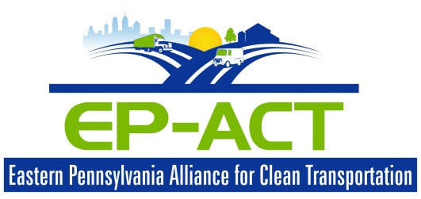
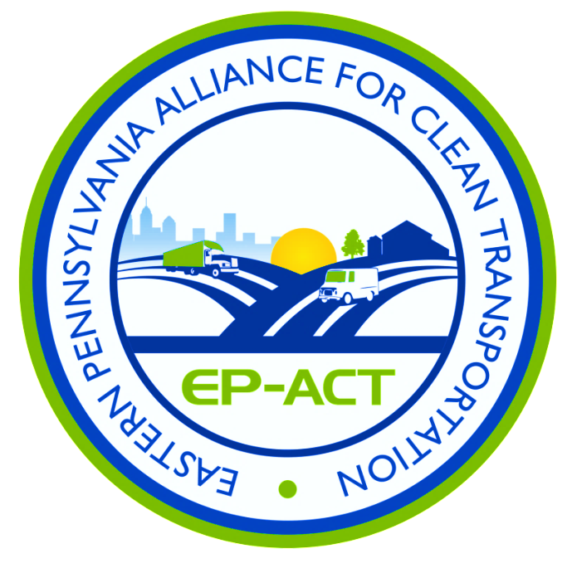
Contact Info
Tony Bandiero
Executive Director
EP-ACT
215-990-8200
tfbandiero@ep-act.org
www.ep-act-org
Notes:
33

